Slide 1
Underwater Wireless
Communication
Presented By
Nikhilesh Shinde
Shyam Kumar Sahu
PCCOE

Slide 2
Outlines
Background &Introduction
UW Architectures and UWSN
Communication Tech. & Layers
Research challenges & Application
Advantages and Disadvantages
Future Expansions
Notes:
Only general

Slide 3
Background
In Early 1990 underwater communication
systems involve SONAR Technology
for Submarine & Obstacle detection.
Underwater wired media for oil & Gas
stations Monitoring.

Slide 4
Why Underwater Wireless networks ?
Wired media does not provides guaranteed
transmission of information.
Much slower speed of acoustic propagation
in water, about 1500 m/s.
Conventional Sound Waves does not work
well in an Shallow underwater environment.

Slide 5
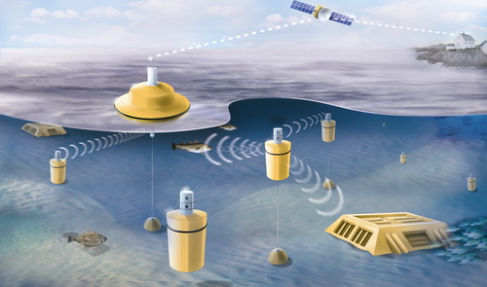
INTRODUCTION

Slide 6
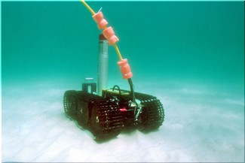
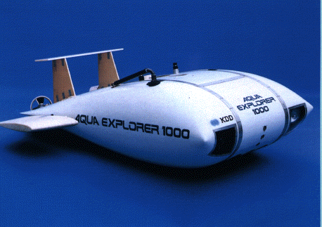
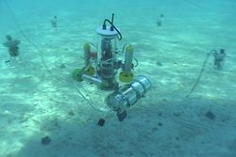
INTRODUCTION
Group of sensors and vehicles deployed
underwater and networked via acoustic
links, performing collaborative tasks
Equipment
  Autonomous Underwater Vehicles (AUVs)
  Underwater sensors (UW-ASN)

Slide 7
UW Architectures and UWSN
Two-dimensional Underwater Sensor
Networks : for ocean bottom monitoring
Three-dimensional Underwater Sensor
Networks : for ocean-column monitoring
Sensor Networks with Autonomous UW
vehicles : for underwater explorations

Slide 8
Communication Technologies
Optical Communication
  IEEE 802.15.4 Based on a VHDL
  LED blue light impulses as Transmitter
  & Photodiode as a Reciever
EM (Electromagnetic ) waves for short range Swarms of Senesor nodes.

Slide 9
    LAYERS
    Adapted MACA to underwater acoustic networks
    Network Layer
      Proactive routing protocols
      Reactive routing protocols
      Geographical routing protocols
      TONE-Lohi Protocol

Slide 10
Research Challenges
  Security & Robustness.
  Traffic Congestion Control.
  Efficient Multiple Access.
  To increase the Limited Battery Power
  To reduce the High delay
    Propagation delay Underwater=5 x Radio Frequency(RF)ground

Slide 11
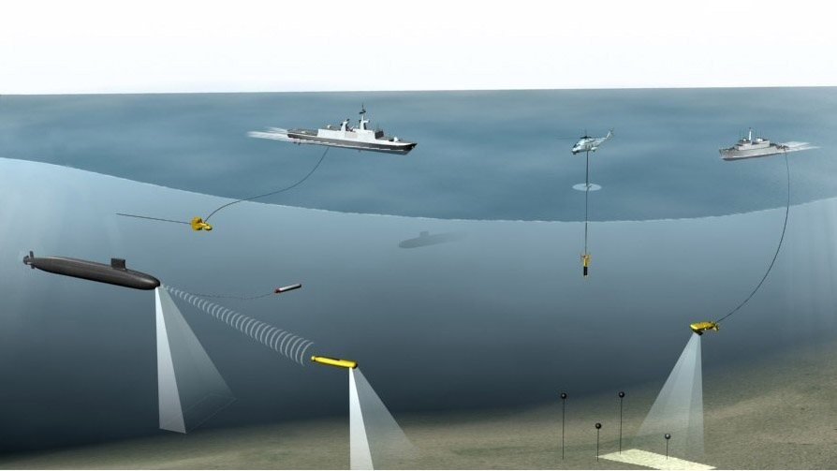
Applications
  Environment monitoring
  Undersea explorations
  Disaster prevention
  Assisted navigation
  Application to oil-field monitoring

Slide 12
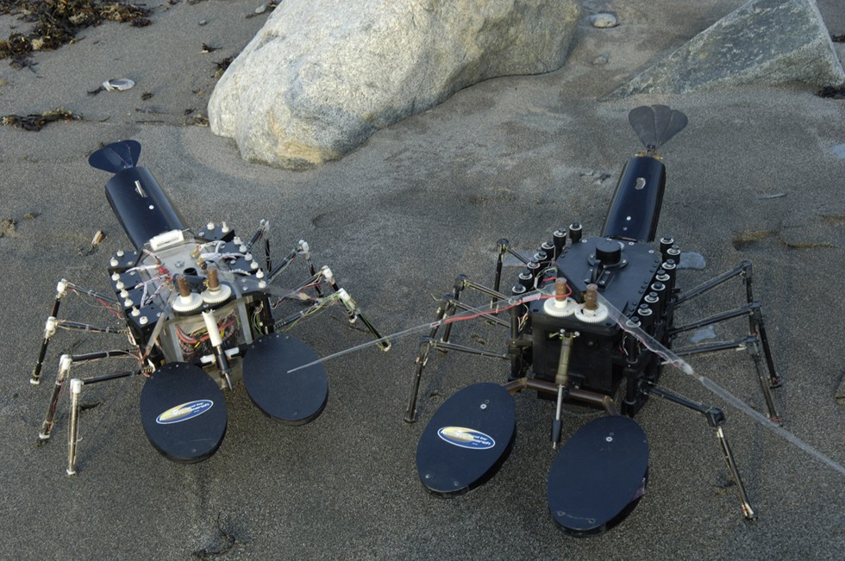
Underwater Remote Sensors

Slide 13
Advantages
Real time Underwater security.
Quick alert monitoring in Between UW-AV
in oil field and gas station.
It can project better for marine researches,
naval systems & submarine for accurate
communication between them

Slide 14
Disadvantages
    UWSNs are expensive
    Power require for UWSNs is higher
    Tendency of failure in the underwater
    sensors because of corrosion

Slide 15
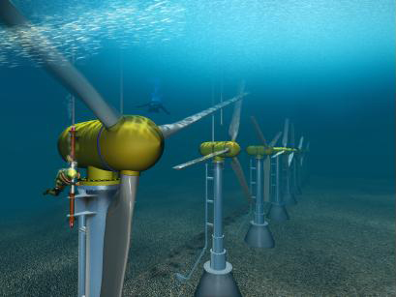
Future works
In future information can be
transmitted digitally over a
wireless network..
A point-to-point optical
communication system, using
laser-emitting diodes (LEDs).

Slide 16
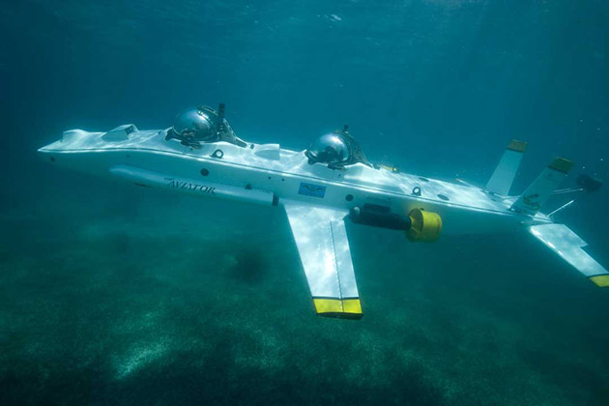
Future Expansions Cont.
Telesonar is an emerging technology for
wireless digital communications .
Seatooth an High speed Data transmission
technology .

Slide 17
Conclusions
Acoustic waves will be staying as
the major carrier of wireless communication
in UWSNs.
Losses can be avoided for long
distance by collaboration of terrestrial
networks and UWSNs.

Slide 18
References
[1] Under Water Sensor Networks at BWN Laboratory,
Georgia Institute of Technology, Available from
<http://www.ece.gatech.edu/research/labs/bwn/UWASN/>.
[2] Ocean Engineering at Florida Atlantic University,
Available From
<http://www.oe.fau.edu/research/ams.html/>.

Slide 19

Thank you!
Any Questions

